Slide 1
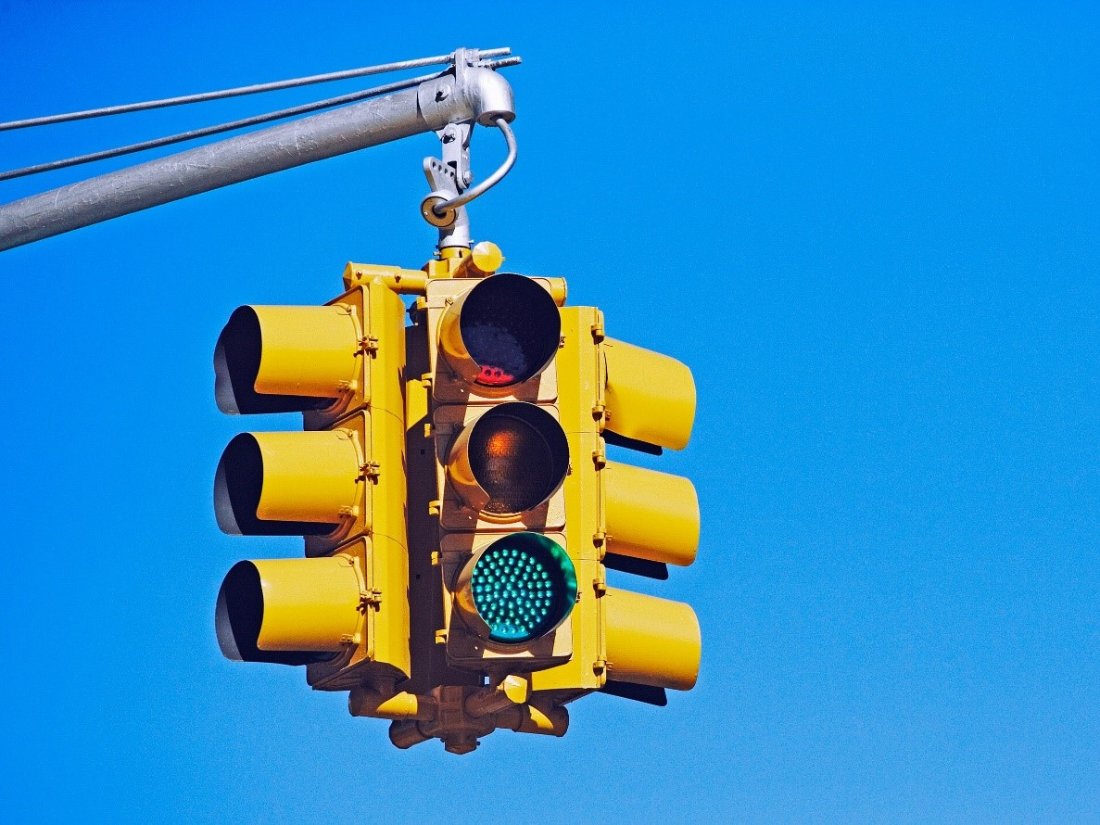
Mini Project
Traffic Light Controller
Course : CS322
By
Kadum Perme
1601CS17

Slide 2
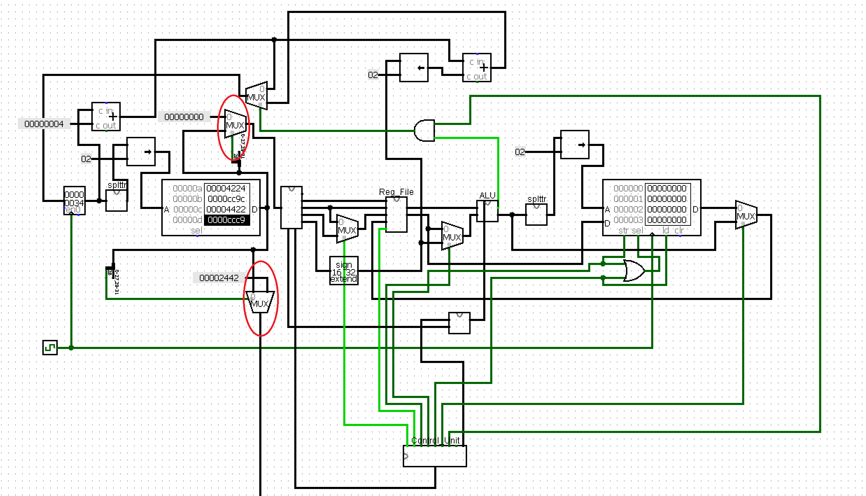
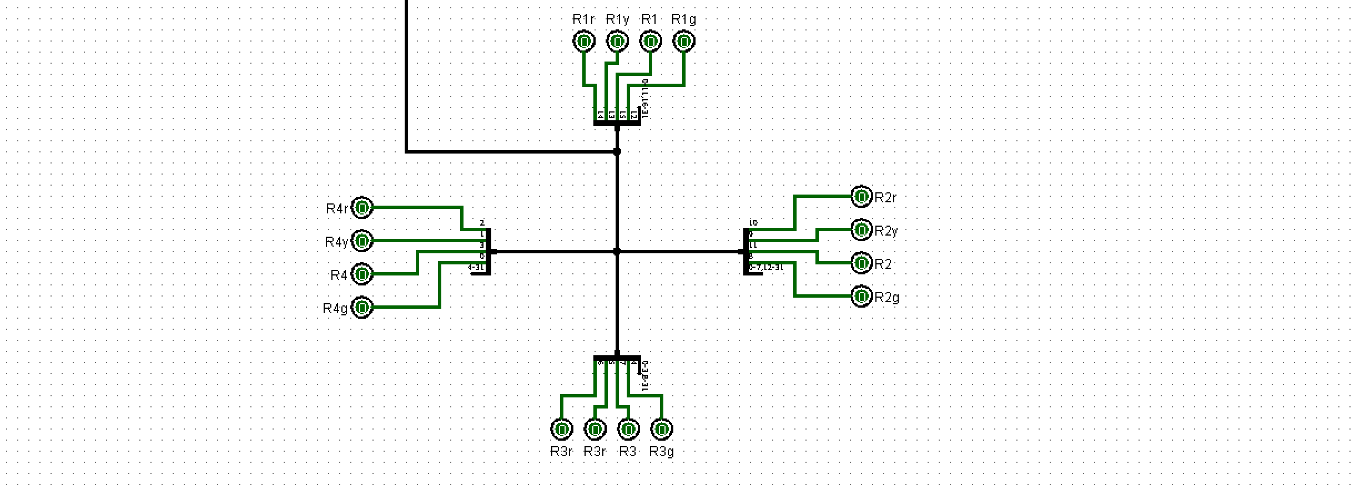
Architectural Design :

Slide 3
Symbol Meanings :
R_{i} = Bit assigned for blinking lights on ith road
R_{ir} = Bit assigned for red light for ith road
R_{iy} = Bit assigned for yellow light for ith road
R_{ig} = Bit assigned for green light for ith road

Slide 4
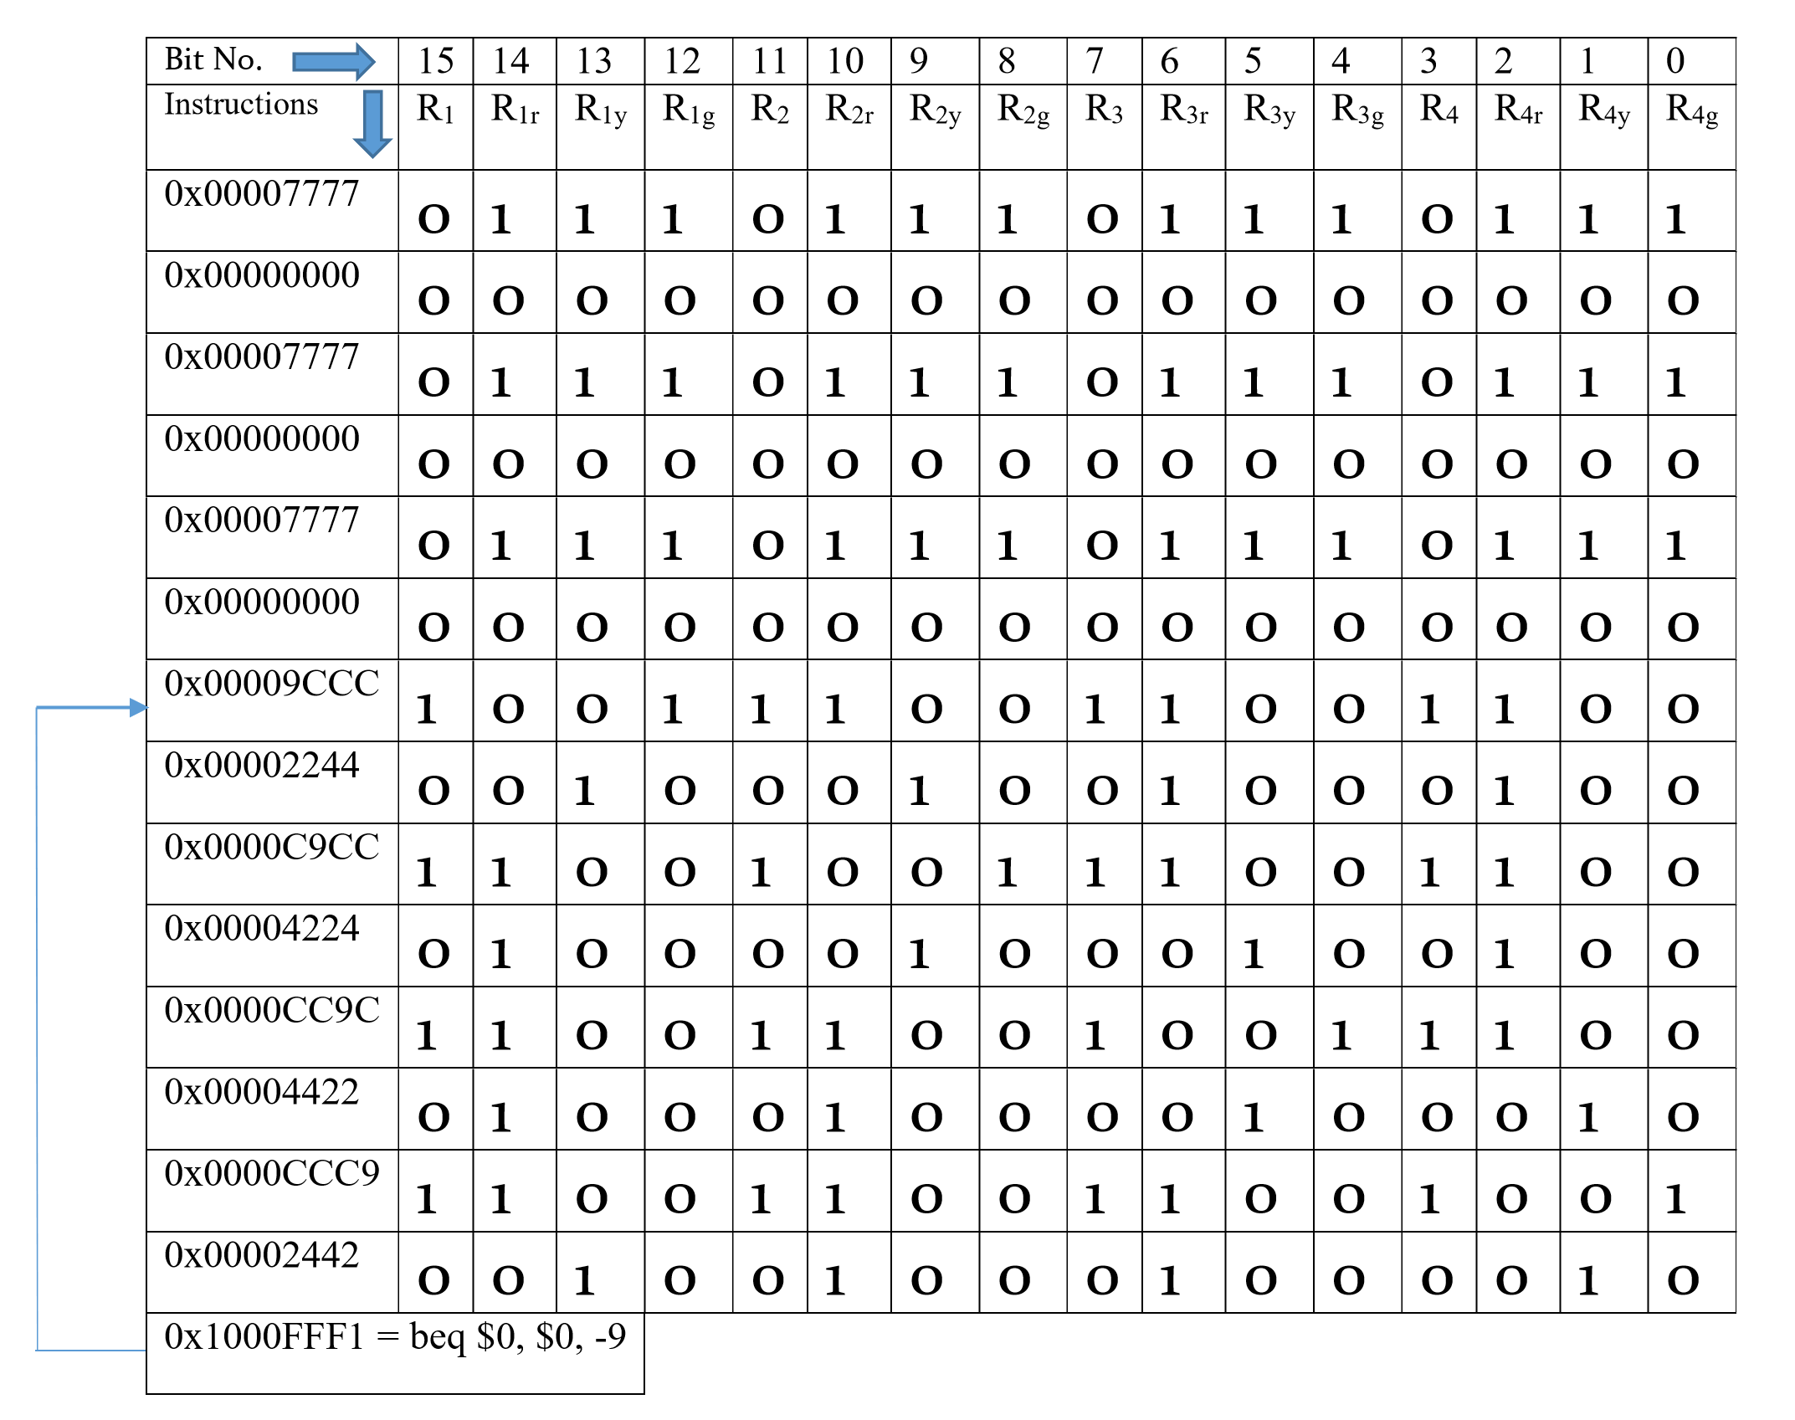
Brief Explanation :

Slide 5
